Slide 1
Employee Data Analysis using Excel
STUDENT NAME : ISSAC AUGUSTIN S
REGISTER NO : 2213211036008
DEPARTMENT : B.COM.-COMMERCE (GENERAL)
COLLEGE : PRESIDENCY COLLEGE

Slide 2
PROJECT TITLE
Employee Salary Analysis using Excel

Slide 3


AGENDA
Problem Statement
Project Overview
End Users
Our Solution and Proposition
Dataset Description
Modelling Approach
Results and Discussion
Conclusion
3/21/2024 Annual Review

Slide 4

PROBLEM STATEMENT
The problem statement for employee salary analysis is that companies often overspend on new hires, which can negatively impact their financial health.
A solution to this problem is to develop a salary prediction model that can help companies estimate the salaries of new hires.

Slide 5

PROJECT OVERVIEW
Assess Salary Distribution: Analyse how salaries are distributed across different roles, departments, and experience levels.
Identify Discrepancies: Detect any gender, role, or department-based salary discrepancies.
Market Benchmarking: Compare internal salary data with industry benchmarks to ensure competitive compensation.
Performance & Salary Correlation: Investigate the relationship between employee performance ratings and salary increments.
Future Salary Projections: Predict future salary trends and budget requirements based on current data.

Slide 6

WHO ARE THE END USERS?
End user | Purpose
Human Resources (HR) Department | To ensure fair compensation, manage payroll, and make decisions on raises or bonuses.
Labor Unions or Employee Association | They may use salary data to negotiate better pay and benefits for their members.
Finance Department | They use the data for budgeting, financial planning, and controlling labor costs.
Employees | Indirectly, employees are end users as salary analysis can influence their compensation, benefits, and job satisfaction.
Department Heads/Team Leaders | To understand the compensation structure within their teams and to plan for promotions or salary adjustments.

Slide 7

OUR SOLUTION AND ITS VALUE PROPOSITION
Techniques used for data analysis:
Filter – To divide the data
Formula – To calculate the average, percentage etc…
Pivot table – To summarize the data
Graphs - Visualization
Our Employee Salary Analysis solution is a comprehensive, data-driven platform designed to assess, monitor, and optimize salary structures within an organization. The solution integrates multiple data sources, including internal salary data, market benchmarks, and performance metrics, to provide a holistic view of compensation practices.

Slide 8
Dataset Description
Features used to analysis
Salary-numbers
Department -text
Tenure-numbers
Gender-
Text
Employee raw data set – Kaggle
Total features – 10 features
Filtered features – 4 features

Slide 9

THE "WOW" IN OUR SOLUTION
AI-Driven Insights: Predictive analytics for future salary trends and personalized pay recommendations.
Real-Time Visualization: Interactive dashboards for salary distribution and scenario analysis
.Fairness Metrics: Tools to ensure pay equity and industry benchmarking.
Employee Integration: Incorporating feedback and career path mapping
Automated Compliance: Automatic checks for legal compliance and tax optimization.
HR Integration: Seamless integration with other HR tools for a unified management system.
3/21/2024 Annual Review
9

Slide 10
MODELLING
Data Collection
Employee Information
Salary Data
Performance Data
Market Data
Data Preprocessing :
Cleaning
Categorization
Feature Scaling
Exploratory Data Analysis (EDA):
Correlation Analysis
Descriptive Statistics
Visualization
10

Slide 11
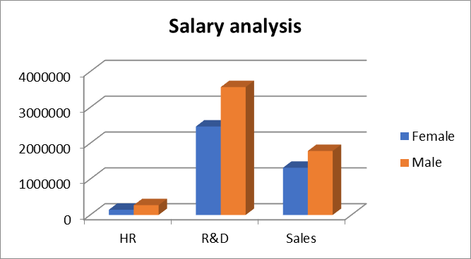
RESULTS
Salary analysis on the basis of gender
11

Slide 12
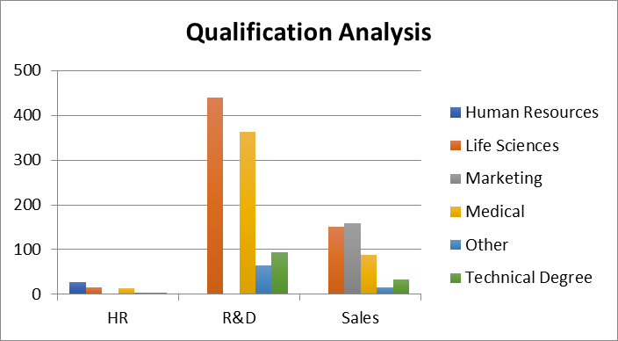
Qualification wise employee analysis

Slide 13
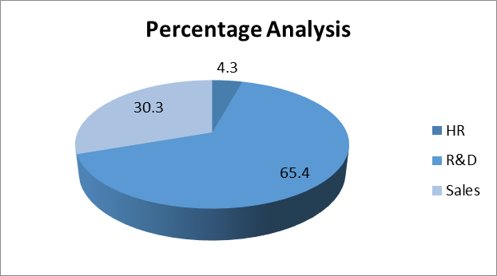
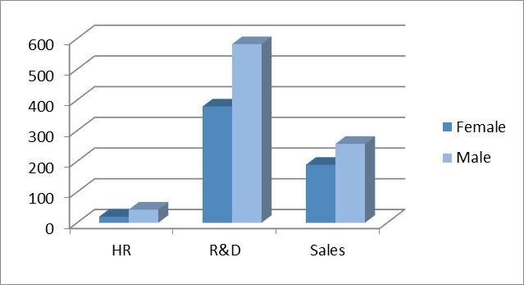
Percentage department
salary analysis
Analysis on the
basis of gender

Slide 14
conclusion
In conclusion, salary analysis is a critical process for organizations to ensure fair, competitive, and equitable compensation structures. By leveraging data-driven models, companies can make informed decisions that align with their strategic goals, improve employee satisfaction, and enhance retention. Regularly updating and refining these models is essential to adapt to changing market conditions, industry trends, and organizational growth. Ultimately, effective salary analysis contributes to a balanced workforce, fostering a positive work environment and supporting long-term business success.

